Slide 1

GAME DEVELOPMENT
USING PYGAME
Project Supervisor: Mrs.T.ANANDHI,M.E.
Student Name : Mr.S.SONISH
Reg.No : 37110729

Slide 2
INTRODUCTION
Game design is the art of applying design.
create a game for entertainment or for educational, exercise, or experimental purposes.
Video games are played and accesed globaly.
Development is a part of gaming.

Slide 3


SOFTWARE CONFIGURATION
Python is used as a major software.
Pycharm JetBrains is used as development platform for compiling the game.

Slide 4
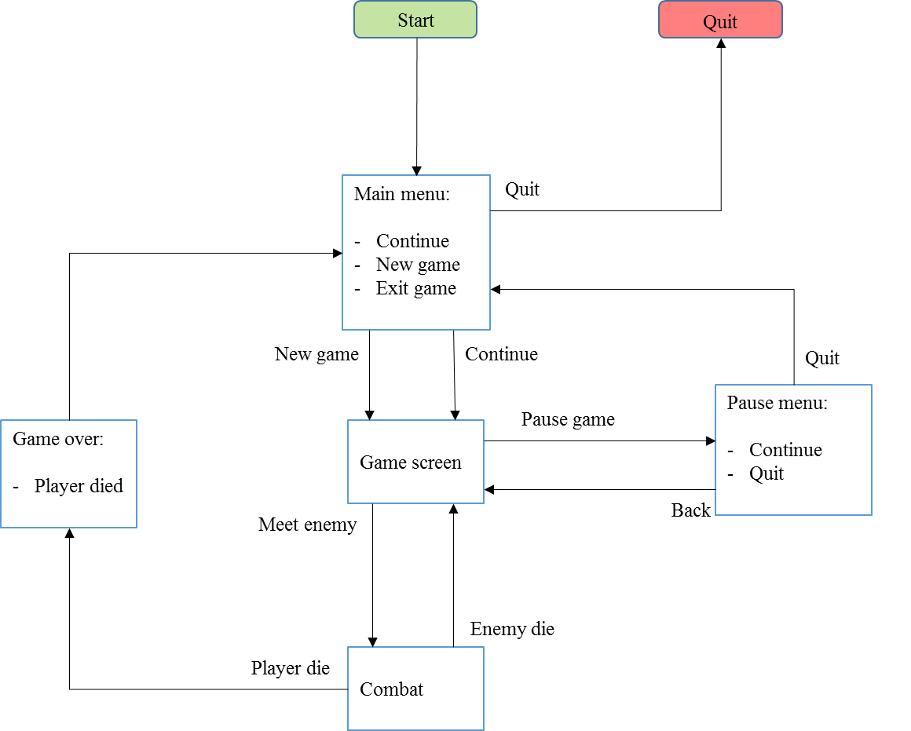
SYSTEM ARCHITECTURE
Initial flow diagram of the
Game.
Basic representation of the game architecture.

Slide 5
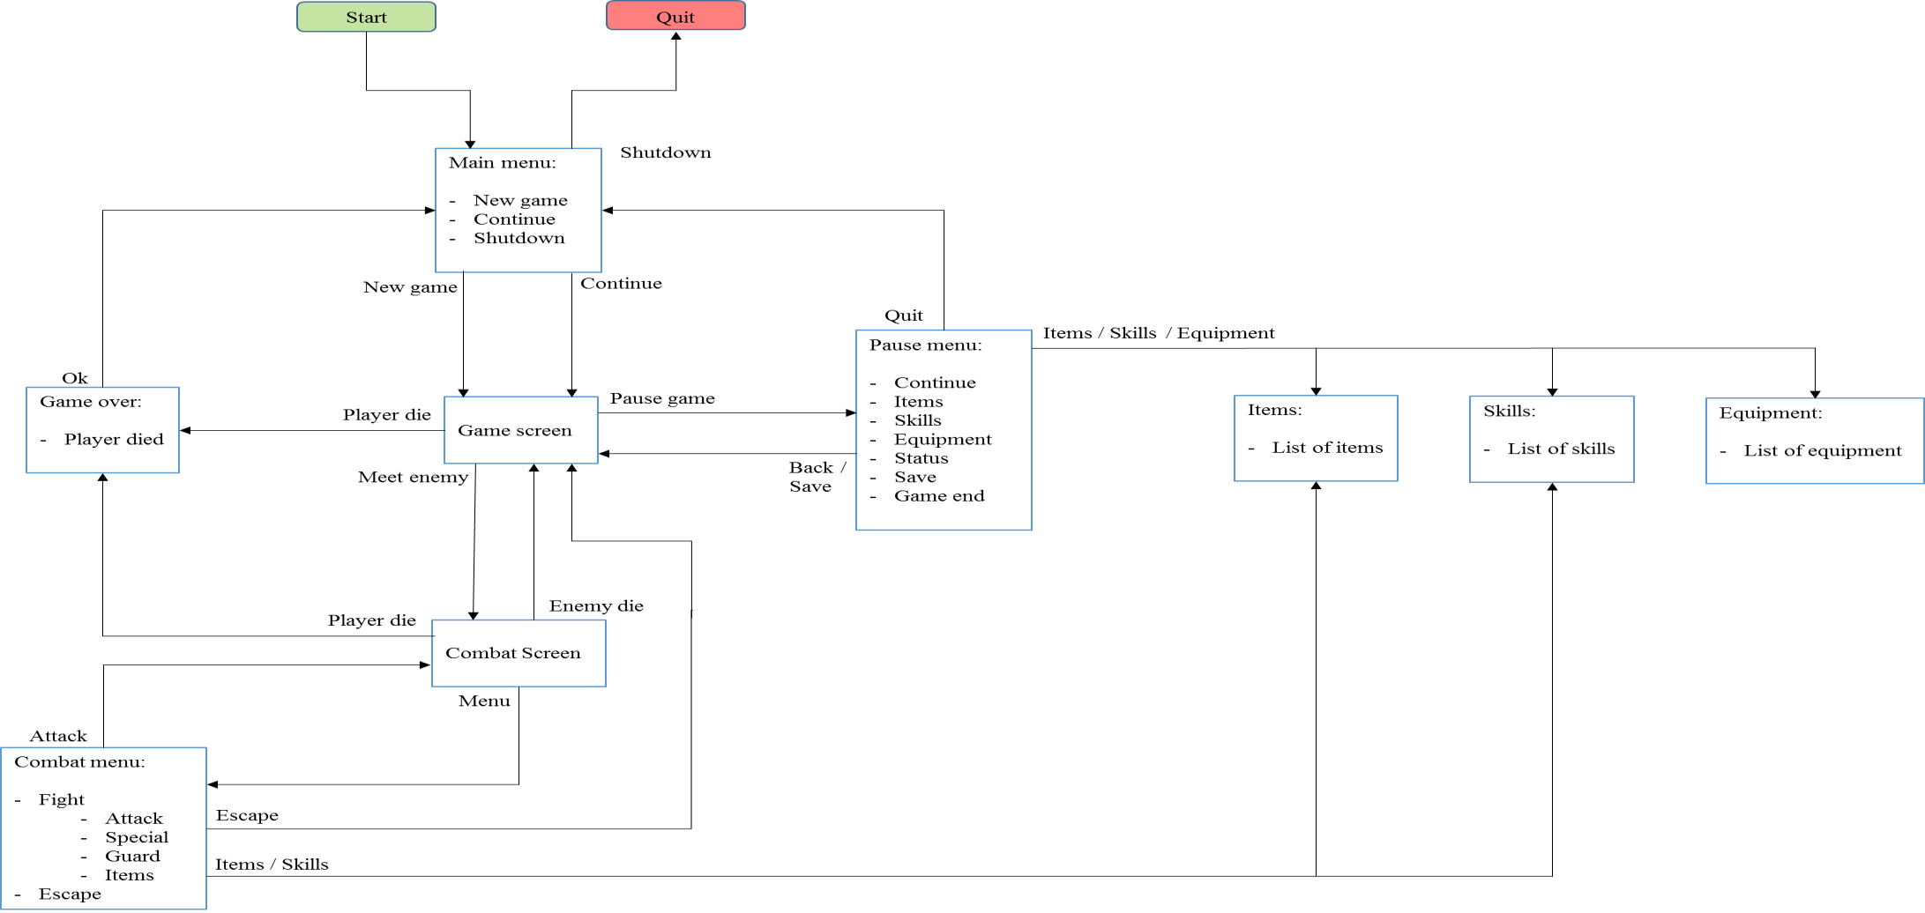
Final flow diagram of the game that is to be build.

Slide 6
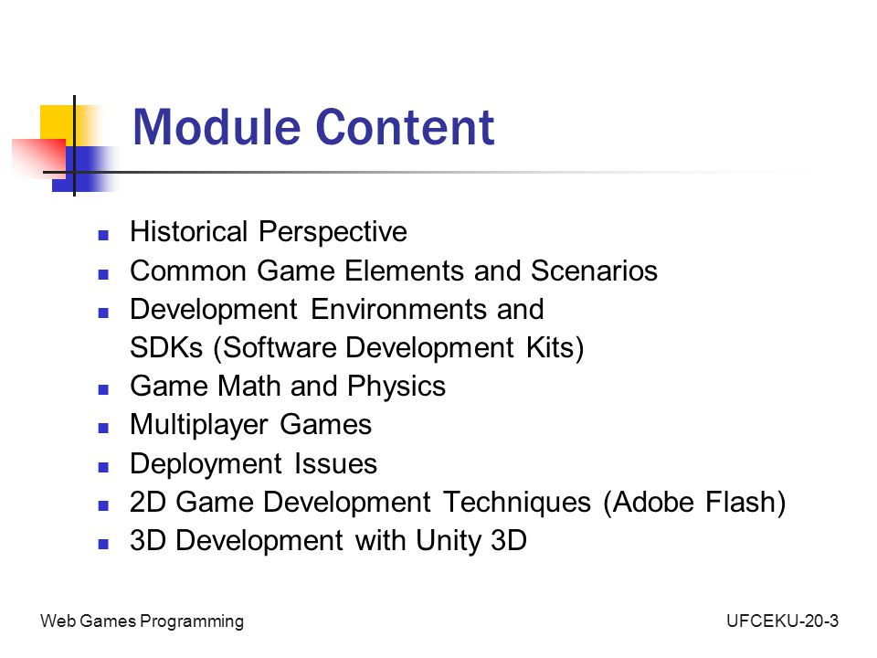
MODULE IMPLEMENTATION

Slide 7
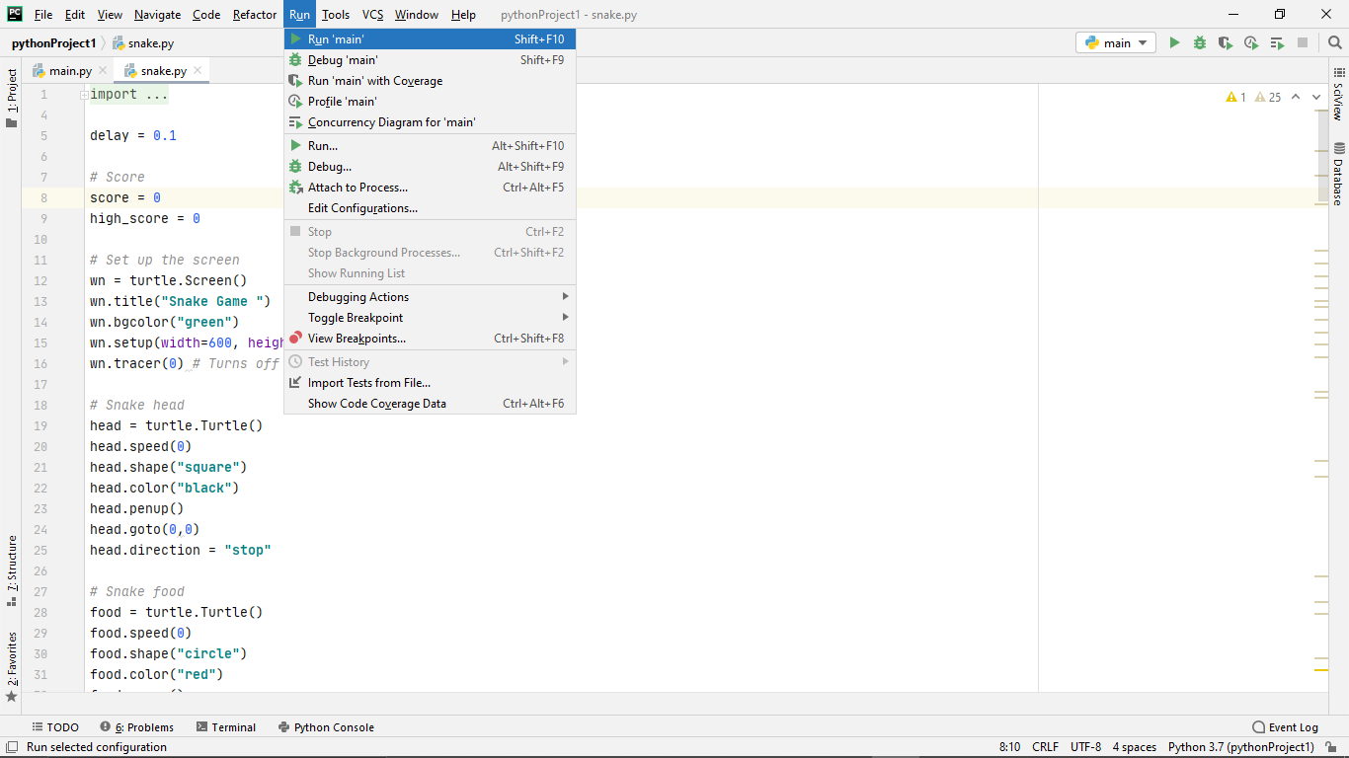
APPLICATION SNAPSHOTS
This is an complier of the source code.

Slide 8
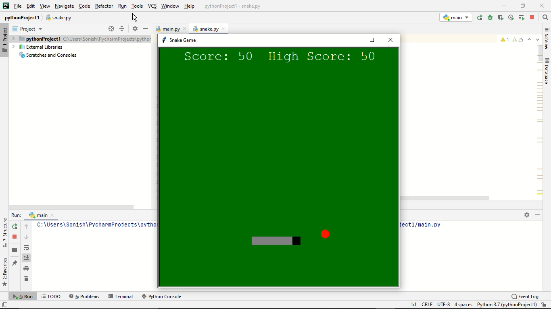
The serial monitor where the game opens up.

Slide 9
RESULTS AND DISCUSION
It is the game development tool which has got whopping community of asset and the plugin developers and you will be able to get the reasonable and free content available.
It also supports the elite range of operating systems and platforms, like the mobile, desktop, and the gaming consoles.

Slide 10
It also supports the assorted range of asset formats which is meant for conversion automatically to maximum formats for the target platform too.
This game development tool is available at the free license and have got class features.

Slide 11
CONCLUSION
To evaluate the use of video games as educational tools.
Investigate educational video games.
Evaluate the video game development process.
Develop knowledge in a scripting language.

Slide 12
Develop a suitable video game.
Evaluate the effectiveness of the video game using appropriate tests.
Identify video game development approaches suitable for modelling educational video games.
To learn and develop skills in a scripting language dependent on the tools used to develop the video game.

Slide 13
REFERENCES
Unity Game Development Essentials
3D Game Development with Microsoft Silverlight 3
Releasing HTML5 Games for Windows 8
A Theory of Fun for Game Design
Writing for video Game Genres: From FPS to RPG
Game Physics Pearls
CryENGINE Game Programming with C++, C#, and Lua
Building XNA 2.0 Games
Computer Games and New Media Cultures
Google SketchUp for Game Design
Unity 4.x Game AI Programming
Real-World Flash Game Development

Slide 14
THANK YOU

